Slide 1


Machine Learning
Hichri Hafedh

Slide 2

What is machine learning
01
Domain and application

Slide 3
the use and development of computer systems that are able to learn and adapt without following explicit instructions, by using algorithms and statistical models to analyse and draw inferences from patterns in data.

Slide 4
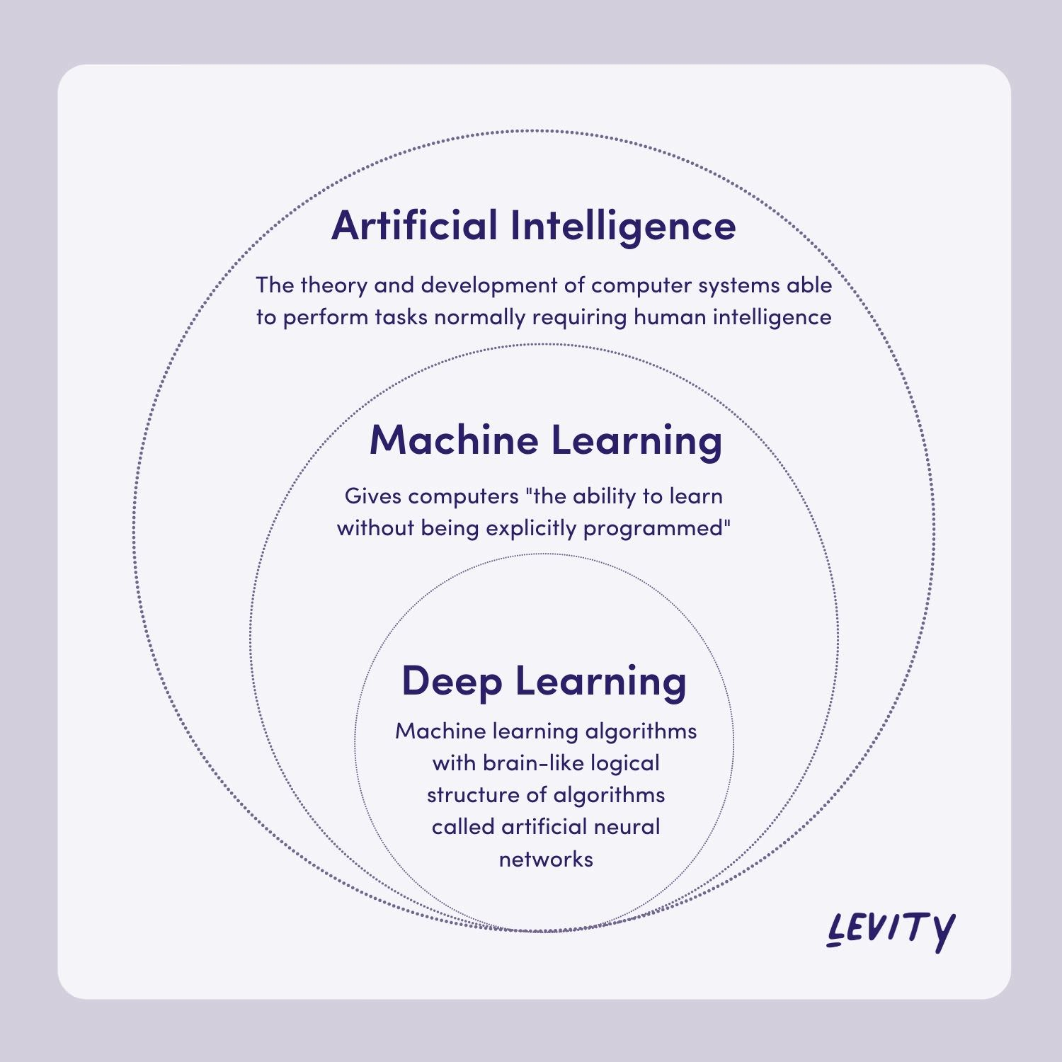

Slide 5
Types of machine learning
02
Domain and application

Slide 6
1. Supervised learning :
Classification
Regression
2. Unsupervised learning :
Clustering
Dimensionality reduction
3. Reinforcement Learning

Slide 7
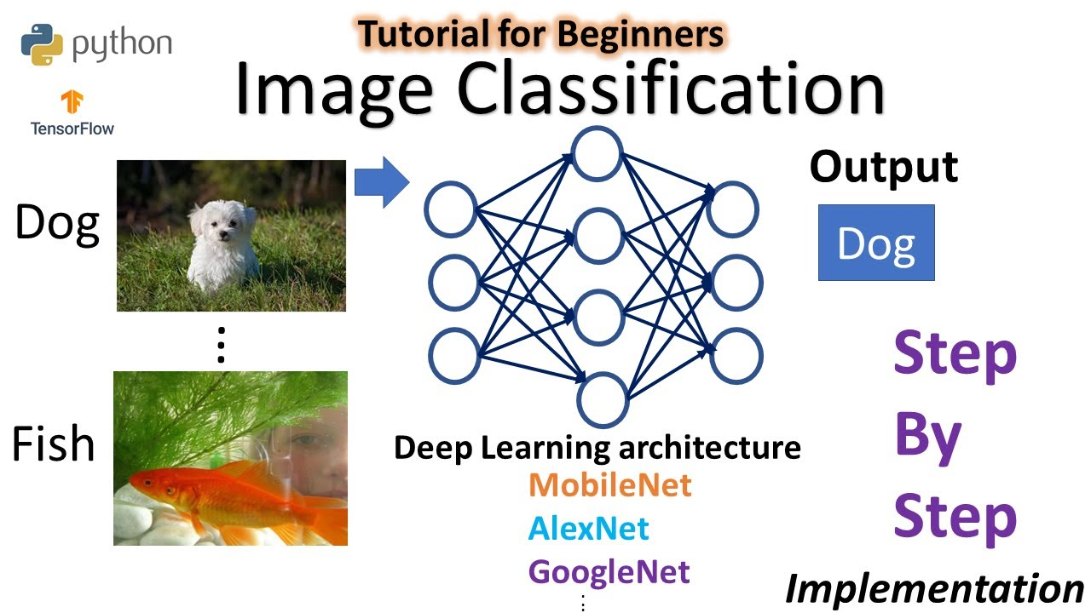

Slide 8
Convolution neural network
02
architecture

Slide 9
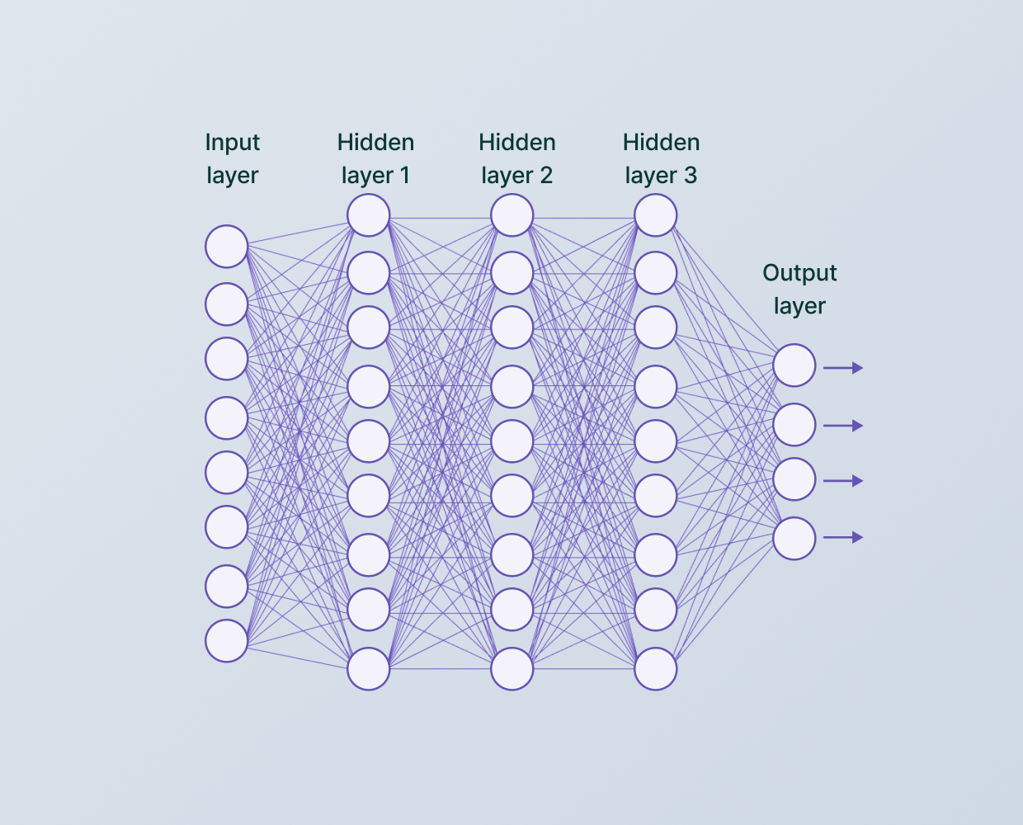

Slide 11
HOW DO WE DO IT?
Flatten
The flatten layer is used after a series of Conv+Pooling to help reshape the information into a 1D matrix
Convolution+Pooling
Convolution layers apply filters to the image and the pooling layer is used to help identify the key features in the convolution layer
Dense
Is typically used in the output layer

Slide 12


Slide 13
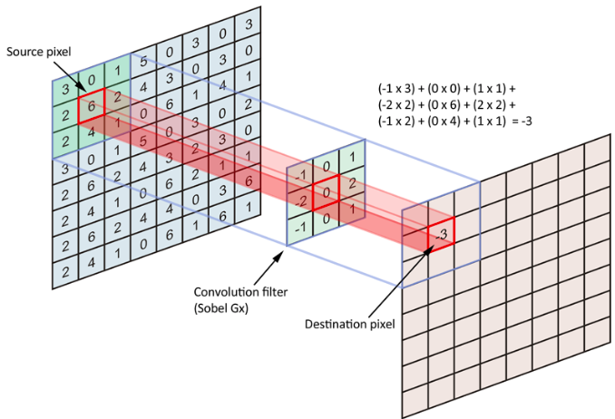

Slide 14
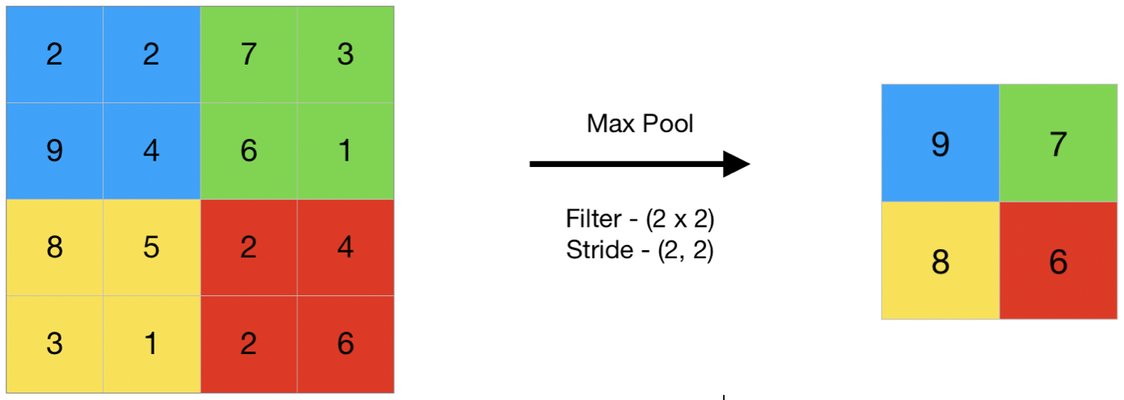

Slide 15
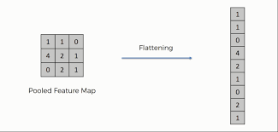

Slide 16
Evaluation
03
Validation and metrics

Slide 17
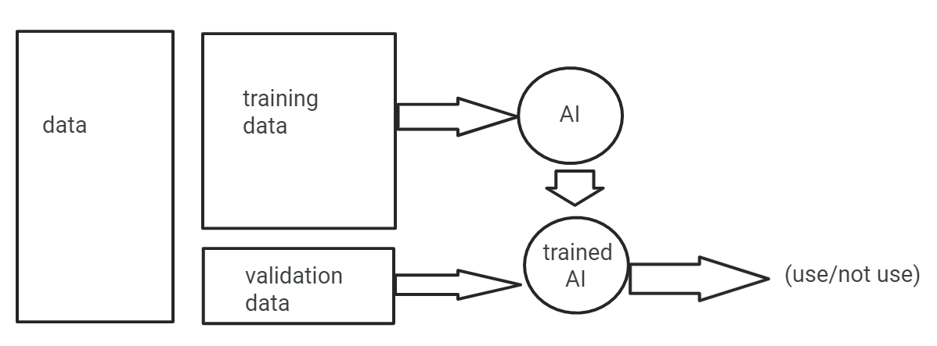

Slide 18
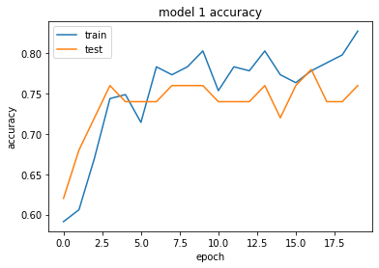

Slide 19
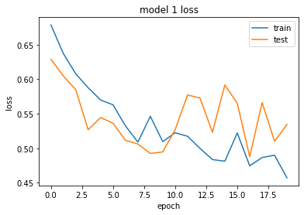

Slide 20

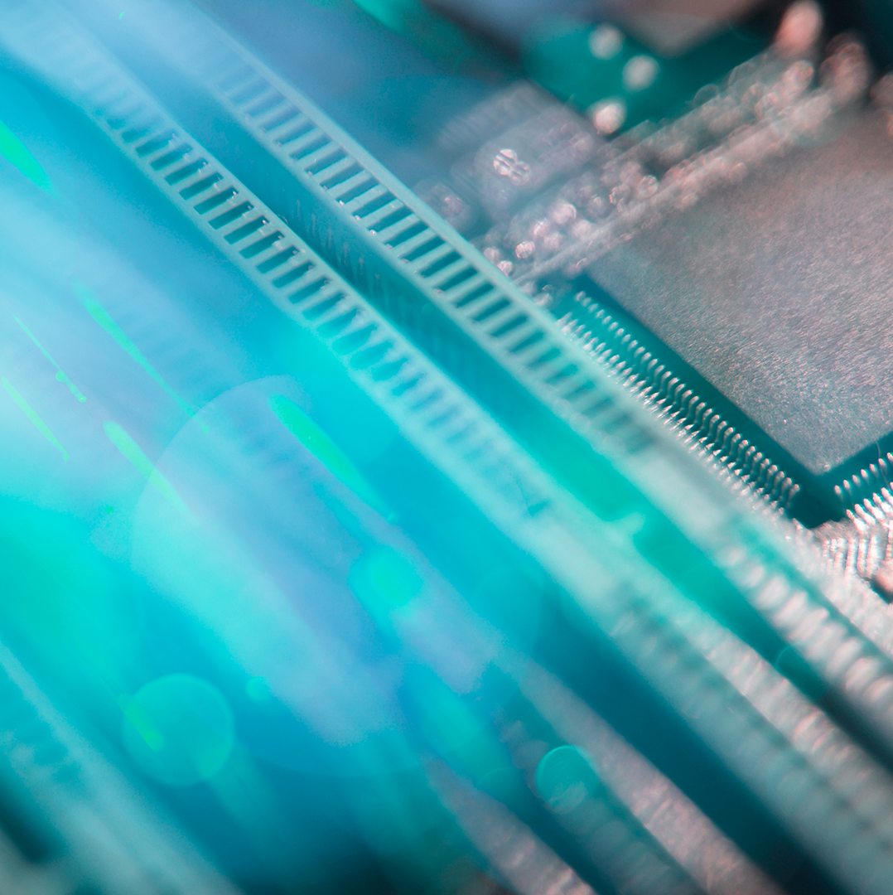
Thanks for your attention

